Slide 1



Awaken your Energy & Design your Life

Slide 2
Prayer
Guru Brahma Guru Vishnu Guru Devoo Maheshwaraha Guru Sakshaad Parabrahmam Tasmai Sri Guruve namaha
Let this Kundalini MahaShakthi Yogam be invoked in the name of Satguru Gurumahan and all the other Guru traditions and 18 Siddhas , Maharishi Patanjali and Mahan Thirumular and Maharishi Agasthiyar. Let their energies be with us
Surrendering to divine mother MahaShakthi herself , we begin the presentation

Slide 3
Agenda
Kundalini MahaShakthi – 5 mins
MahaShakthiYogam Course Structure – 15 mins
Kundalini maha Upadesam– 10 mins
Aura – 5 mins
Personal Intro and About Gurumahan – 10 mins
FAQ – 30 mins

Slide 4
Kundalini Maha Shakthi
Fundamental Shakthi for all other Shakthis, hence it is called MahaShakthi
Difference between Yogas
Yoga is Reunion of Kundalini Maha Shakthi from the base of spine to the Top of the brain. When its done primarily through
Physical Energies – it is called Hatha Yoga
Mental Concentration – it is called Raja Yoga
Atma Vichara through the Intellect – it is called Gnana Yoga (Vedanta)
by Selfless service and Work – it is called Karma Yoga
through Love – Bhakti Yoga
by KUNDALINI herself – it is called Kundalini Yoga , MahaShakthi Yogam

Slide 5
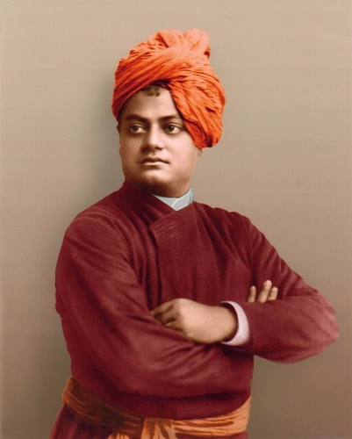
Swami Vivekananda
Rousing of the Kundalini is the one and only way to attaining
Divine Wisdom, super conscious perception, realization of the spirit.
Rousing may come in various ways, through love for God, through the mercy of perfected sages, or through the power of the analytic will of the philosopher.
Wherever there was any manifestation of what is ordinarily called supernatural power or wisdom, there a little current of Kundalini must have found its way into the brain.
All worship, practices, consciously or unconsciously, leads to this end.
What, thus, man ignorantly worships under various names, through fear and tribulation, the yogi declares to the world to be the real power coiled up in every being, the mother of eternal happiness, if we but know how to approach her.
Yoga is the science of religion, the rationale of all worship, all prayers, forms, ceremonies and miracles.
“Arise , Awake and Attain . Stop not until Goal is reached”

Slide 6
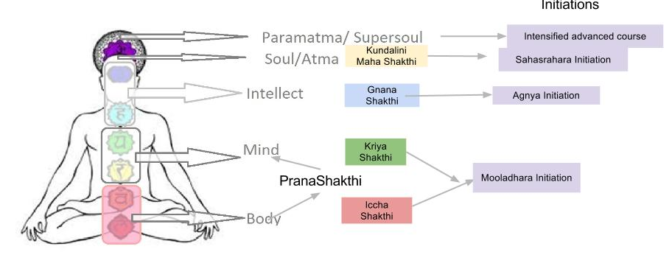
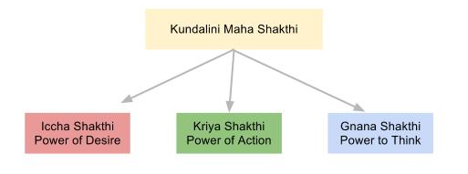
Concept of MahaShakthi

Slide 7
Course Structure
Module | MahaShakthiYogam | Purpose | Application
1 | Prana Shakthi | Cleansing of Chakras , Nadis Pranayama | Stress Release , relaxation More Pranic Energy Calming of the mind
2 | Gnana Shakthi | Mooladara Meditation Agnya Initiation / Meditation Bandhas, Mudras | Clarity of thought , Decision Making Intuition , Questioning Nature Self Confidence Karmic Cleansing
3 | Atma Shakthi | Sahasrahara Initiation Meditation Pranic Cycling | Experience of Bliss Connection with Cosmic Energy Higher Senses
4 | Advanced Course | Spiritual Development Development of Aura More Kundalini Shakthi | Intense connection with a living master Yogic subtle practices Back brain meditation renews past life memories
5 | MahaShakthiYogam Teacher Training | Communication of Experiences to a normal practioner Understanding different students | Professional teacher for MSY
6 | Wisdom Teacher Course & Initiation from GuruMahan | Serving the world Path of Tapas,karma Dharma , GuruBhakthi to awaken humanity to power of Kundalini MahaShakthi | Selflessness Makes the personal journey to Realisation that much more practical Being in the Guru Parampara is mandatory for being a Wisdom Teacher

Slide 8
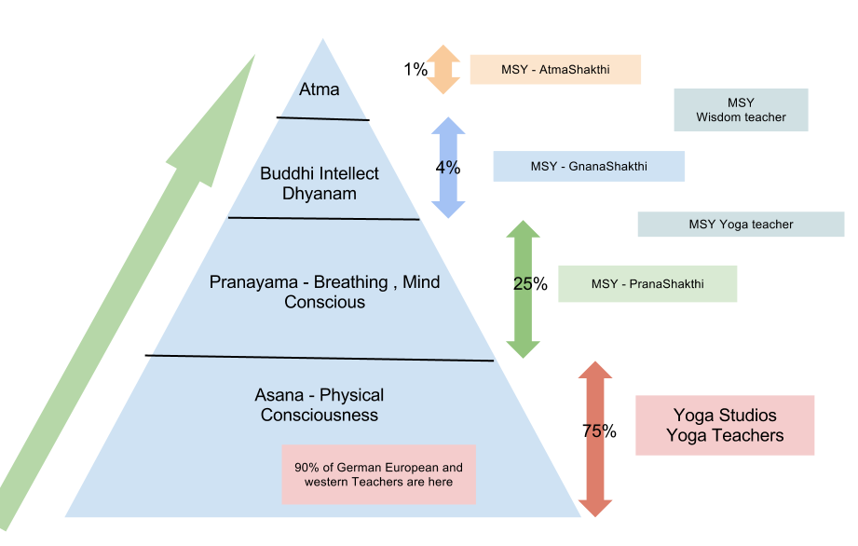
Yoga Trends – where people stand?

Slide 9
MSY PranaShakthi
In todays world cleansing of the Nadis is both a requirement for Yogic practioner and normal man
Breathing practices , simple pranayama for
Less stress
Increasing mental space
Dynamic & Deep breathing practices

Slide 10
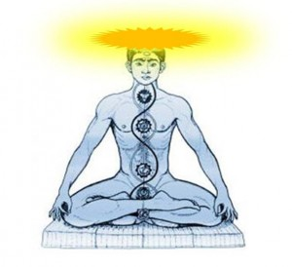

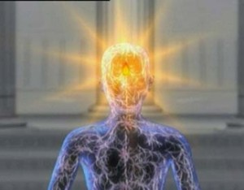
Agnya – Third Eye
Kundalini MahaShakthi Upadesam
Sahasrahara

Slide 11
Kundalini MahaShakthi Upadesam
A experienced Kundalini Wisdom teacher can make others realize the MahaShakthi through his / her own field
Once initiated a pulse, heat sensation or pressure sensation is felt in forehead and Sahasrahara.
Observing this 20 minutes in morning and evening is called Kundalini meditation
One can follow any belief system as they want. For the first 3 weeks after initiation Brahmacharya is recommended for feeling the experience
Only a Kundalini spark is awakened during initiation, practioners practice devotion and dedication does the actual awakening step by step
No miracles , practice and development will be slow but steady until all the chakras turn upwards

Slide 12
Phases of Development
Since karma has to be cleansed , many people misunderstand this experiences as some negativity. Large heart is required for continuous practice.
Also Ego shall be removed through regular practice. Many practioners cant accept this
Hence Bhakthi and surrender to MahaShakthi is advised from very beginning
No miracles , practice and development will be slow but steady until all the chakras turn upwards
Intense Problems are stirred up during course of practice , solving them gives Wisdom. That’s the only way. But Shakthi works in mysterious ways to sincere practioners.
So if a Sadhak wants to reach Truth, acceptance, patience Humility Regular practice and continuous meditation is required.
Easier to awaken Energy but difficult to hold or maintain at Sahasrahara
Secrets of nature will be revealed from within and there is no way to learn from books

Slide 13




Aura Comparisons of normal people
Guru Mahans Enlightened Aura
No body is visible. Central Light is Kundalini reaching Sahasrahara – Samadhi- Divine Light in the Brain
Inference – MahashakthiYogam brings more Solar, Lunar and Light vibrations into Aura

Slide 14
About Vijay
Born 1983,Had seeking since age 10 , wanted to experience God & Universe
Age 15-19 was a period of intense Karmic challenges and character building with school, college and society
Searched for a Guru and Met Gurumahan and Got initiated on Nov 14 2002 into mighty Kundalini Yoga .Dec 2005 – jan 2006 participated in 21 day penance for 15 days, everyday 8am to 4pm
Sep 2006 – Coming to Germany: Aug07, mar08 – Adv Course London
From April 2008 – Yoga classes in Frankfurt and Berlin
Jul 2009 – Wisdom teacher initiation and marriage
Jul 2010 onwards – Ingolstadt and Munich

Slide 15
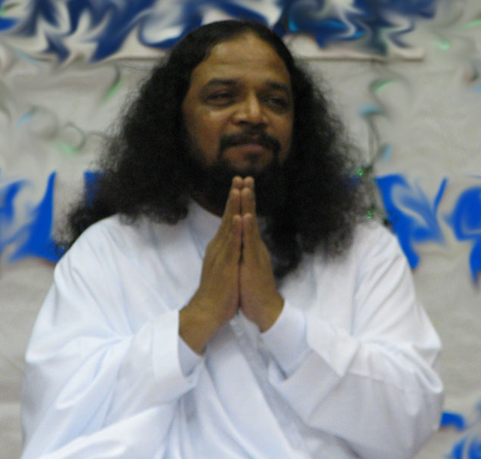
About MahaRishi GuruMahan
Gurumahan was born Jayamani – 1955
Age of 7 , had Out of Body experience,
Took inner Guru to be Swami Vivekananda
Strong thirst to see God
12 years of practice and at age 19 met Gnanavallal Paranjothi mahan , got Initiation and got enlightened , got married at 25
Kaya Siddhi
Yoga Siddhi
Gnana Siddhi
In 1994, Started his own ashram “Universal Peace Foundation” in Thirimurthi hills because of a Vision, the birth place of Maharishi Patanjali

Slide 16
Universal peace through Individual peace
Started the 1 min meditation at 11.11am approved by Malaysian parliament for world peace and by mayor of Omaha, Nebraska, US
Was awarded UN peace ambassador by UN Malaysia branch
Performs penance inside Pranavalayam (Pyramid) for 21 days in silence for welfare and transformation of the world
This year he is continuing penance for 64 days for the Protection of Mother Earth

Slide 17
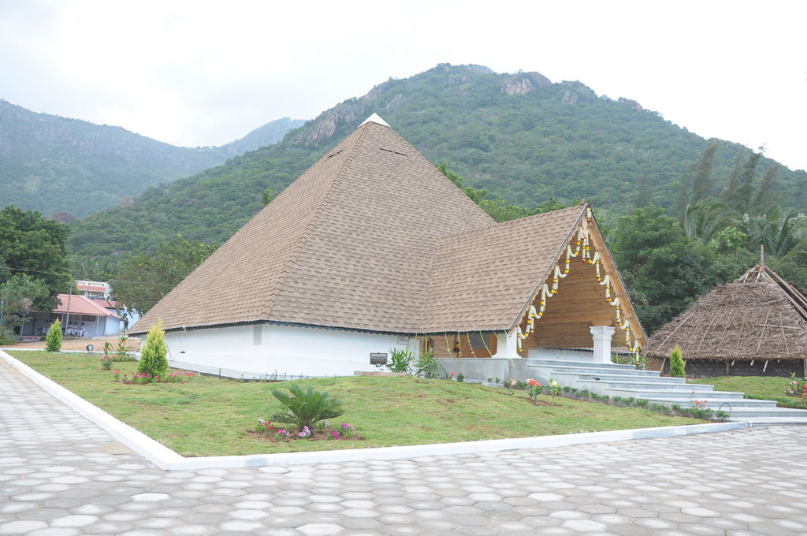
Pranavalayam

Slide 18
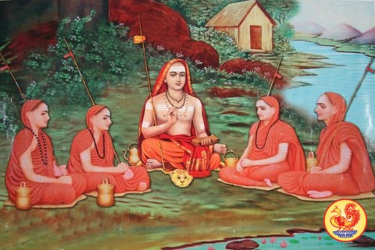
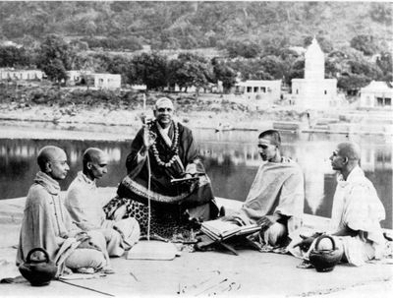
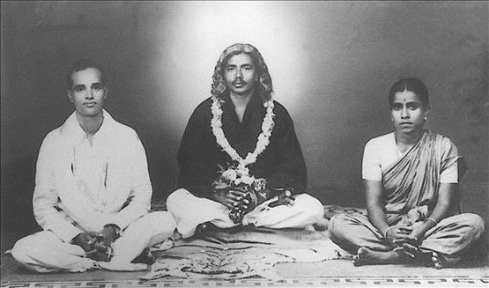
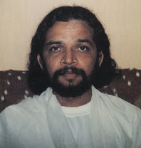
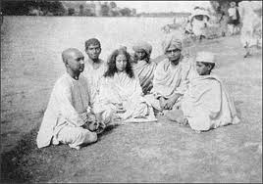
Guru Shisya Shakthi Paramparas
JagatGuru Adi Sankara
Swami Sivananda
Paranjothi Kundalini Tradition
Paramahamsa Yogananda
Gnanavallal, Vethathri Maharishi
Gurumahan Paranjothiar

Slide 19
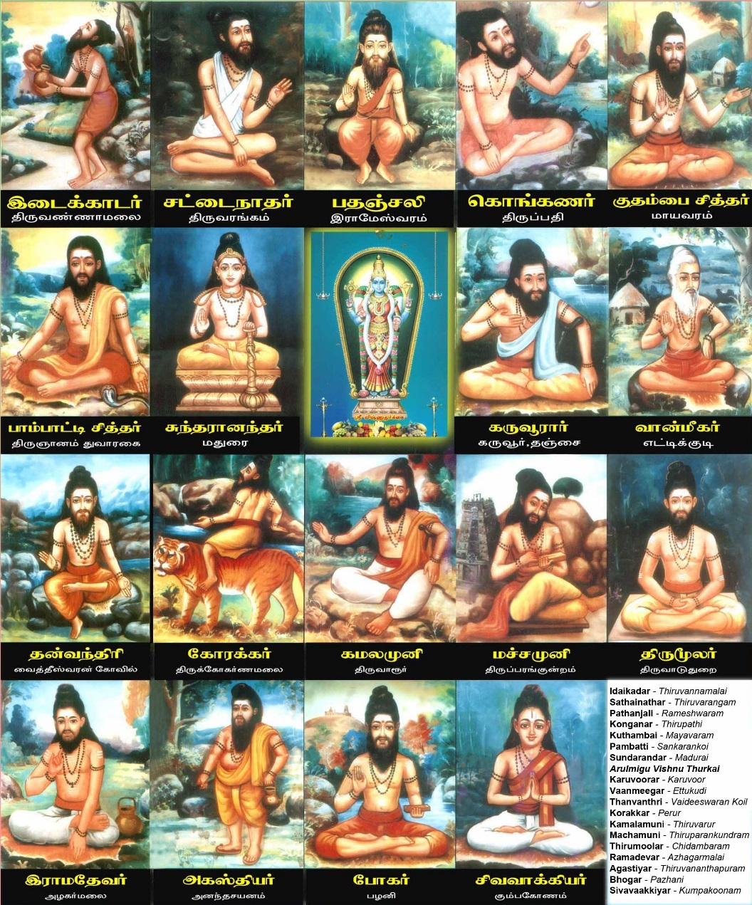
18 Siddhas - Perfected Kundalini Masters

Slide 20
Vichara - Questions

